Slide 1
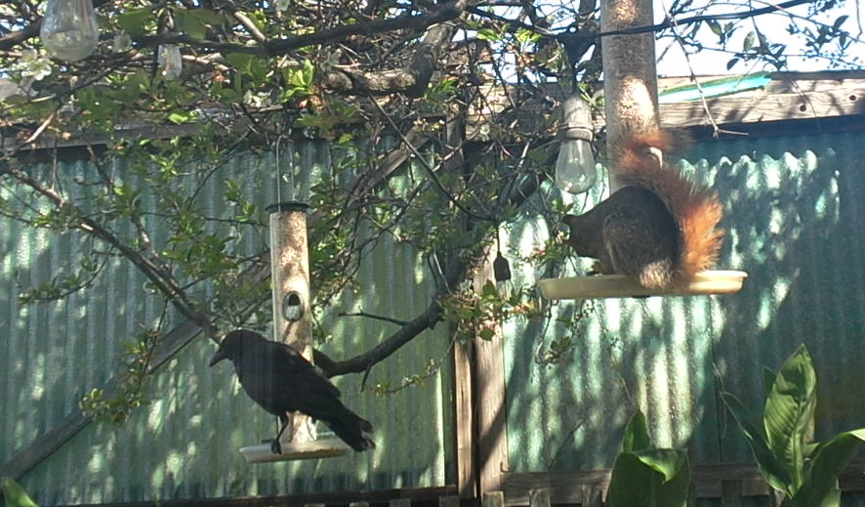

Machine Learning Image Based Pest Species Identification For Embedded Systems
Joshua Mehlman, SFSU ID #903035606, JMehlman@sfsu.edu
SFSU ENGR 859 Spring 2024

Slide 2
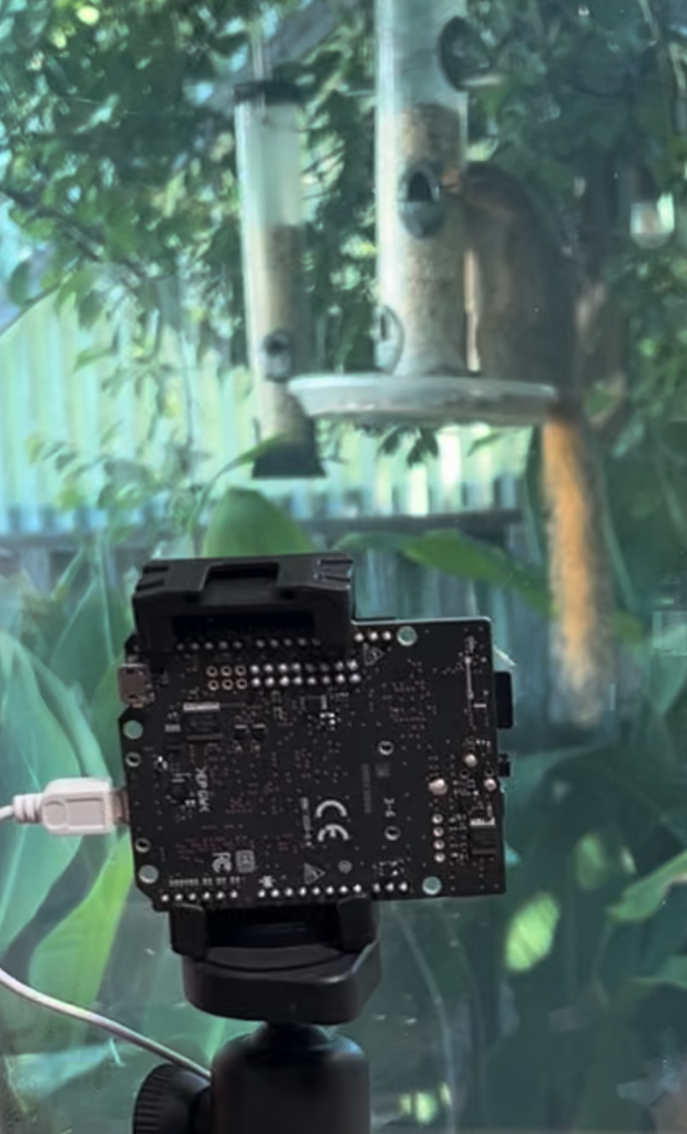
Pest Species Identification
Use Real Time Camera Data
The target species:
Eastern Fox Squirrel
Any bird
Running on Sony Spresense Microcontroller
Notes:
The goal of the system is to…
In our area the easter fox squirrel is an invasive species, crowding out native squirrels, and over competing with many birds for resources.
I am targeting bird food resources issues.
And more that that, we would like to run on a micro controller.

Slide 3
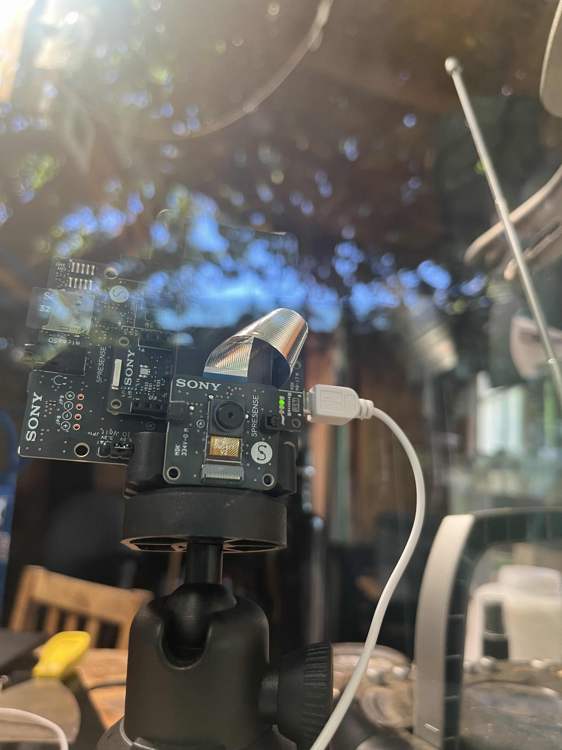
Hardware
Microcontroller^{[1]}:
ARM Cortex-M4F @ 156 MHz
SRAM: 1.5MB
Expansion Board
SD Memory Card Slot
Camera
Image Transfer: CMOS 8-Bit Parallel
Control interface: I2C
Sensor: 2,608x 1,960 (~5 M pixel)
Component | Model | Price
Single Board Copmputer | Sony Spresense CXD5602 | $65
Computer Storage Board | Sony Spresense Extension Board | $45
Memory Card | 32GB MicroSD | $20
Camera | Sony Spresense Camera (ISX012 Sensor) | $35
Notes:
The system is based around the Sony Spresense CXD5602

Slide 4
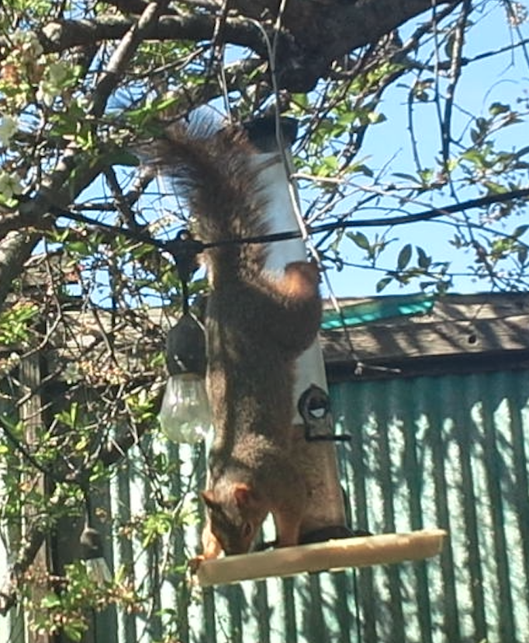
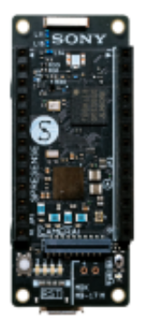
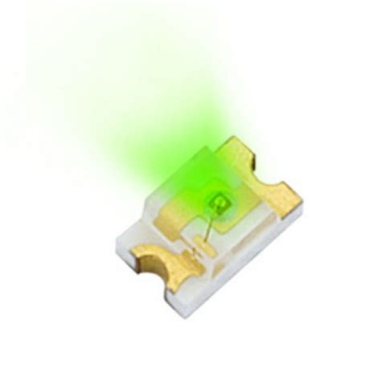
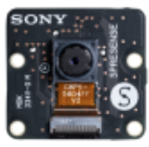
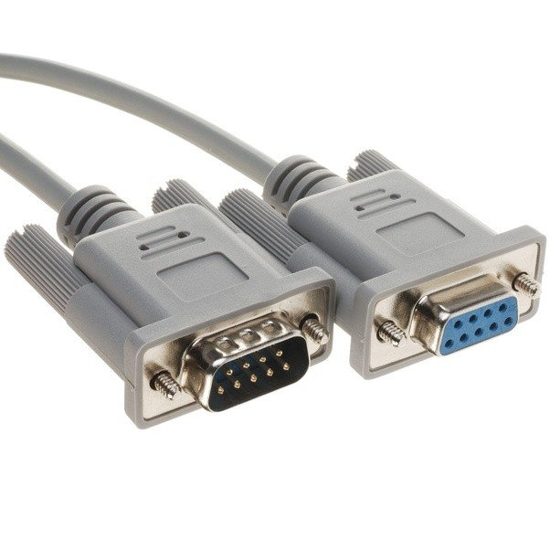
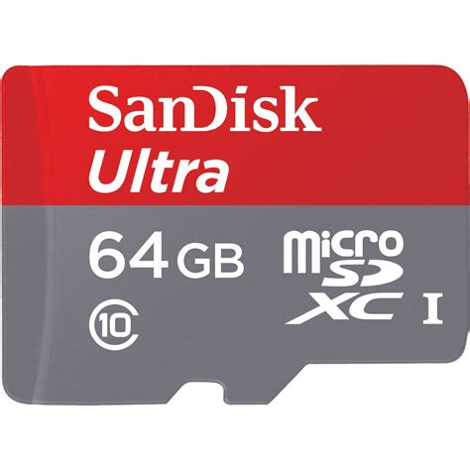
System Overview
LED1 | LED2 | LED2 | LED4
Inference | Bird | None | Squirrel
Notes:
By the way, I have a LOT of pictures of squirrels!
Capture the image
Process the image and send to Model
Interpret results
Save Results: Image file and log
Light up indicator LEDs
Stream image OR log to serial

Slide 5
Pipeline/Flowchart
Capture Initial Dataset
Tag Dataset
Trigger of Video Image
Copy Images and Log from SD Card
Build Model
Capture Still Image
Tag Dataset
Train Model
Process Video Image
Export Model
TFLite-Micro
Run Model
Analyze Performance
Interpret Results
Light Up Indicator LED
Load Model
Notes:
The left is preliminary steps, the center is Realtime, with postprocessing to the right
The initial data set in as high of a resolution as possible (3MP, the camera is 5MP, but there is not enough memory for that and literally anything else.)

Slide 6
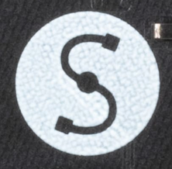





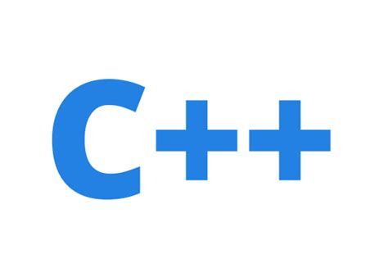




Toolkit/Tec Stack
Initial Data Set: Sony Spresense SDK in C under NUTTX
Image Tagging: Manual File Operations/Python Scripts OSX
Model Building/Training: Python, PyTorch
Model Deployment: TensorFlow Lite – Microcontroller, C
Runtime: Sony Spresense Arduino in C++, Logging to Linux
Data Analysis: Python
Image Stream Viewing: Serial → “Processing”, Java
Notes:
Fun fact: there are about 2,000 lines of code in this project.

Slide 7
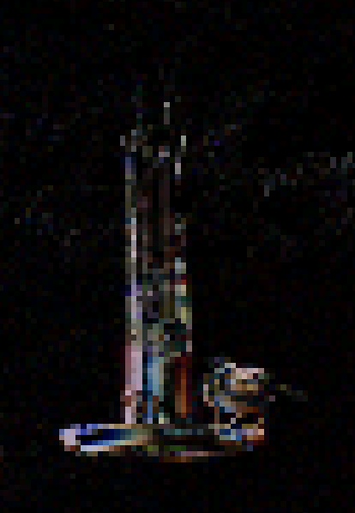
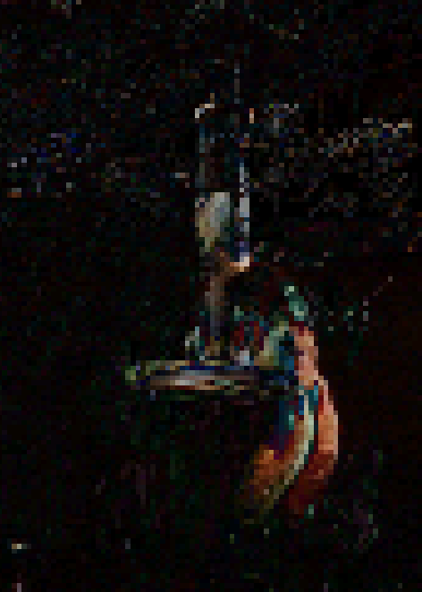
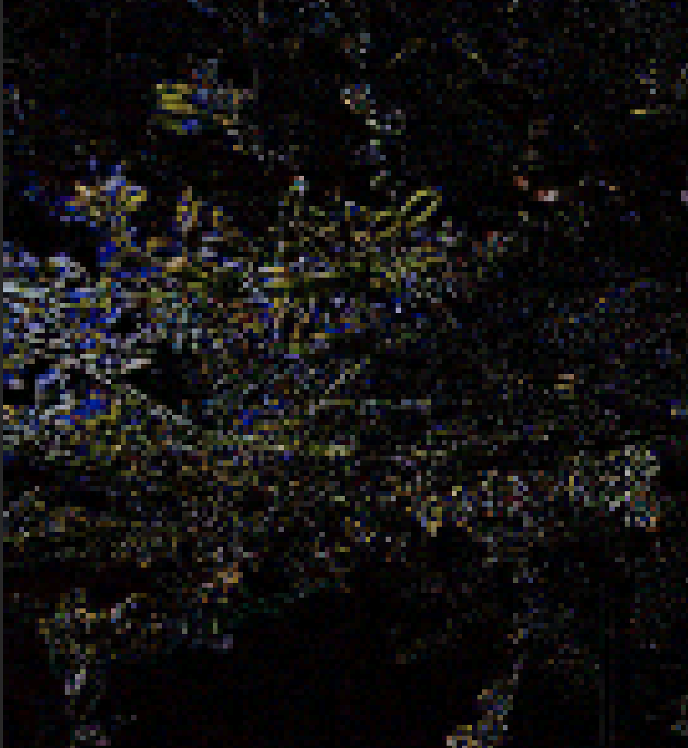
Gather Initial Image Set
Trigger On Motion to Capture Initial Dataset
Save the largest image we can as a JPEG
Subtract each BITMAP from the prior image
Subtract the R, G, and B from each prior to each image.
Give up and just capture on a timer
Notes:
This did not work well. Too much branch motion, even if I ignored the Green channel
There are cool things you can do with image diffraction gratings and so on…
Tantalizingly close, Showing a bird, squirrel, and wind but…
Lets just capture a lot of images and manually tag them.
I should probably use some sort of Machine Learning to find the objects…

Slide 8
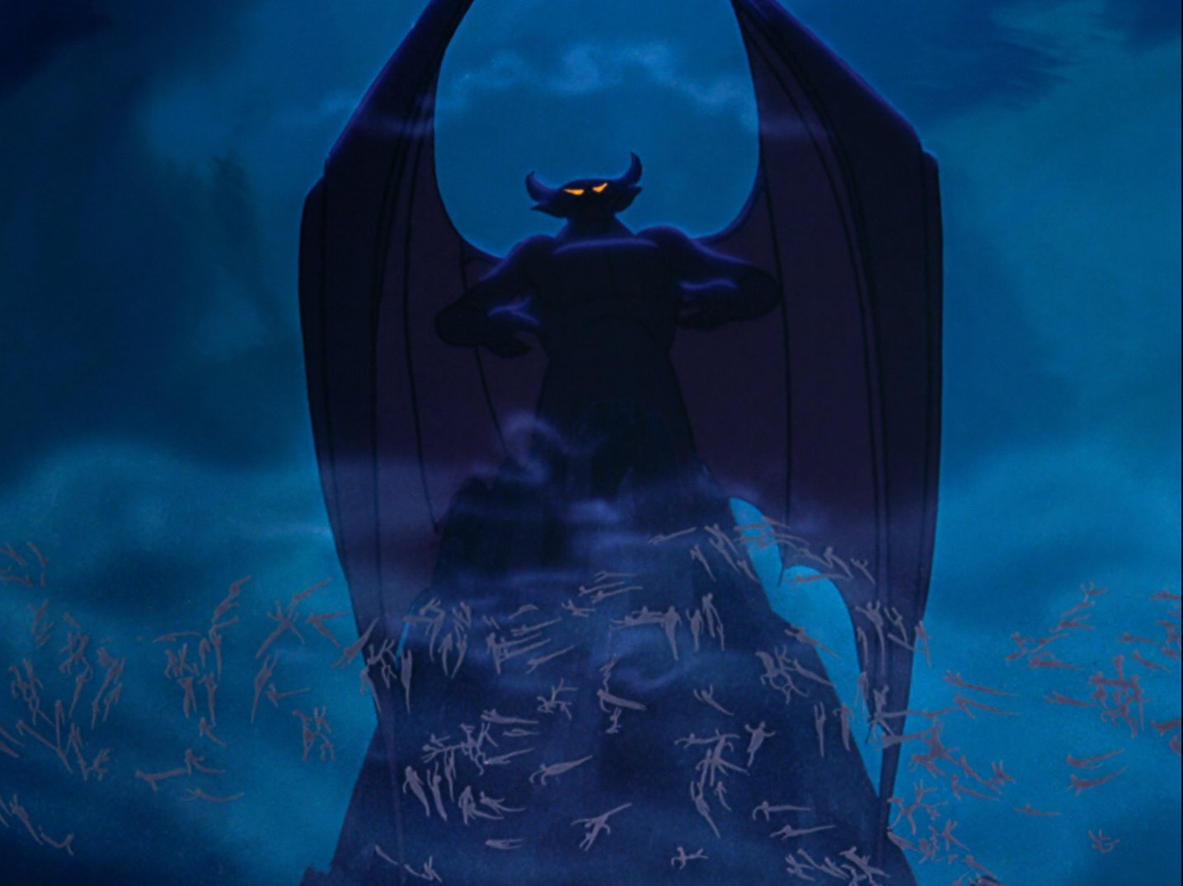

Get Working on Device
Start with super tiny modified LeNetV5 model to find out how large of image size we can handle.
Initial model size ~50kB
Still: 3M (At JPG Qual 70)
Video: 640x480
Notes:
The library has demons!
No, not daemons, demons!
There is a lot of potential there, but its just to temperamental.
I would do a make, it would break.
Immediately do a make-clean, still broken.
Do another make-clean, and it would start working again.

Slide 9
Start Over With Arduino Library
Start with super tiny LeNetV5^{[2]} model to find out how large of image size we can handle.
Initial model size ~50kB
Still: 640x 480 (VGA)
Video: 320x240 (QVGA)
Smallest image size is: 96x96
Max model size:
Camera Memor:1.5 MB
Image Size at QVGA: 153.6kB
Notes:
There is no way a 96x96 image will work.
This is called “Foreshadowing”
The SDK was able to use larger images.
Also, had a much richer feature set, including image rotate and flip… I had to dismount, and remount the camera.

Slide 10
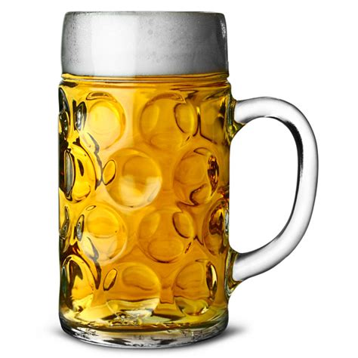
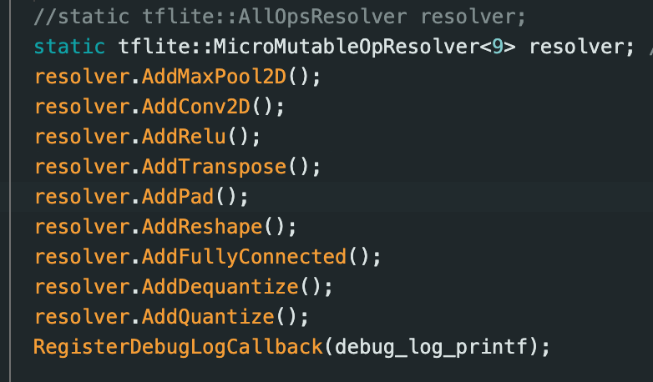
Model Wont Build
The Sony Spresense TFLite Build has no logging.
MIC to the rescue: The MIC Spresense TFLite Build Shows what is missing
Notes:
I didn’t even know I was using some of things missing.

Slide 11
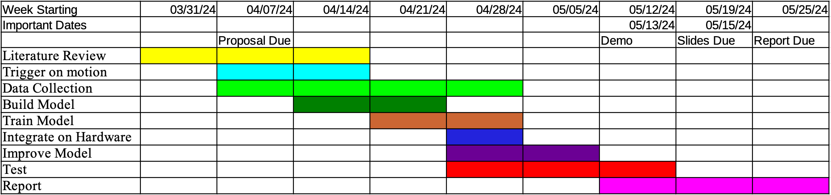
We have Pipeline! Now Build The Model
Next Steps:
Build Model
Capture Many More Images
Tag Images
Train Model
Export Model
Install on Device
Start with a full sized leNetV5 with
Input: 2x96x96 Model Size = 480kB
Input: 2x160x120, Model Size = 1MB
Image size Max for 480kB model:
Video Stream: 320x240 (QVGA)
Stills: 320x240 (QVGA)
Remaining space: ~400kB… Not enough for even 160x120 (QQVGA)
Notes:
We have pipeline! Just one small compiler warning.
Something about onnx-tensorflow being past end of life. I’m sure it unimportant (more foreshadowing)
All that’s left is
Crap!
Ok, we do not have enough time left for SSD or Yolo.
Just the image tagging alone will kill two full days. And we are looking at 2 weeks till demo!
Ok, lets find out how big we can go… That’s, uh, not a lot.

Slide 12
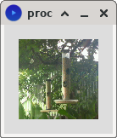
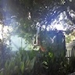
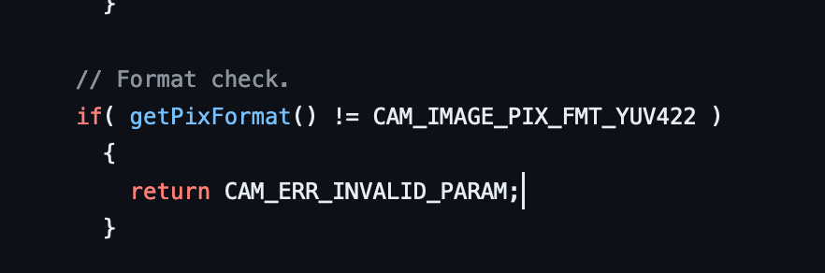
No Way It Will Work on Full Image
Have to go to 96x96 images to fit…
Crop, not scale
The Spresense Camera Arduino library Can only zoom with:
CAM_IMAGE_PIX_FMT_YUV422
Fun Fact: The only errors the camera seems to know is:
return CAM_ERR_INVALID_PARAM;
return CAM_ERR_NO_MEMORY;
Notes:
:Wait, crap!
400kB is not anywhere near enough to even to to 120x160 for the model input!
And 96x96 is small, how small? That is too small.
How about a crop instead... Yeah, I think I can work with that.
Guess how long that took to find out?
I saw both of these errors quite a lot
But the camera front end is open. Start at the beginning and go over each error condition:
Gotcha!

Slide 13
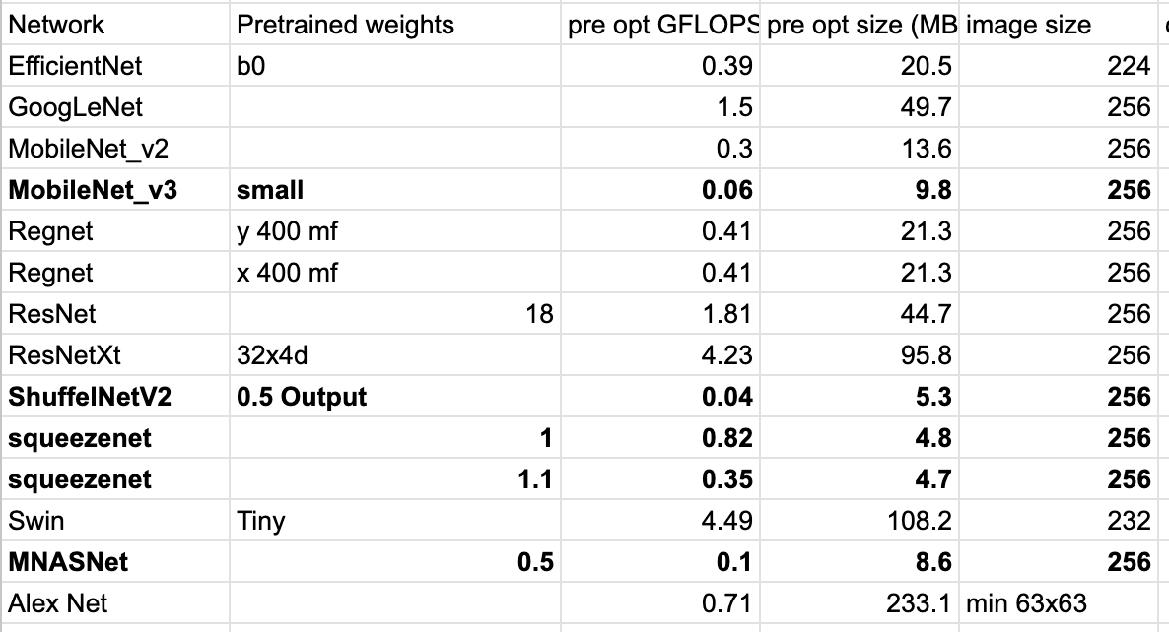
New Plan: Skip Object Detection Use Classifier Only
Start with a pretrained model, prune and quantization
Model List:
Size on 96x96:
AlexNet: 10MB
MobileNetV3: 6MB
Notes:
Ok, new plan
Lets take a look at the pre-trained models available.
I got less than 1MB of space to work with… Oh boy.
Ok, 6Meg / 4 for the quantization, will be 1.5… I can prune in half… right?

Slide 14
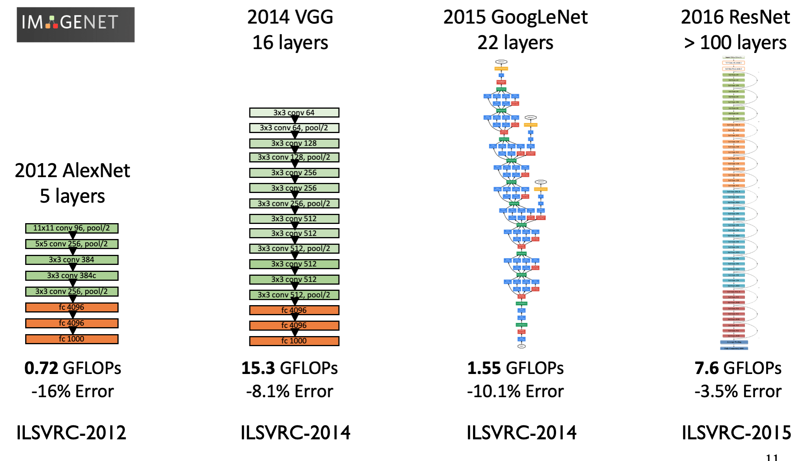
Pruned Pre-Trained Model
Failed
Failed
Failed
Failed
What am I missing???
Notes:
Before GoogLenet, everything is linear, one step then the next.
This means the input of each layer is “easy” to trim based on the input from the prior… But after that our path is not so simple.
Pruning that nonsense is way over my paygrade.
Thanks for the help on that Mr Lin

Slide 15
New Plan: Build and Train Model From Scratch
Continue using the LeNetV5
I have a good understanding of how to train
Got good results, and was fast on Fashion MNIST
Once that is working, move to the more complex MobilNetV1
Notes:
What's a 20 second inference time among friends?

Slide 16
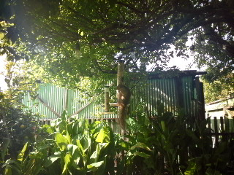
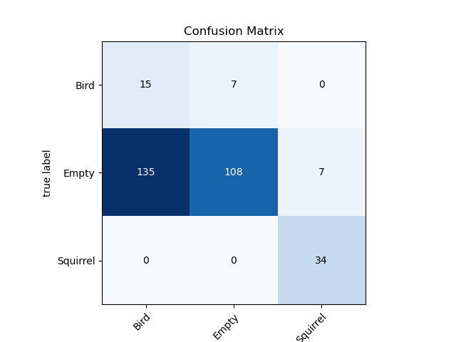
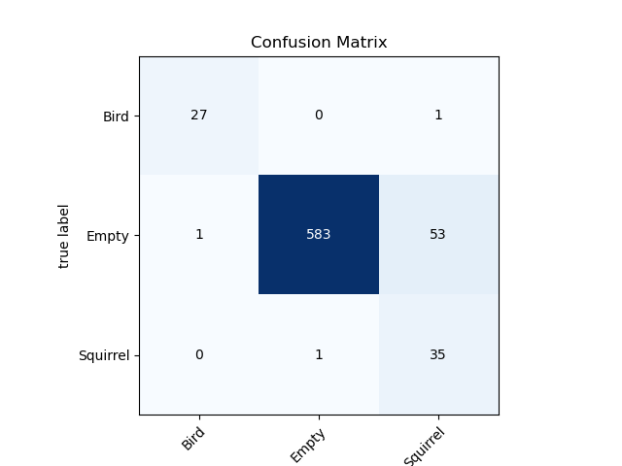
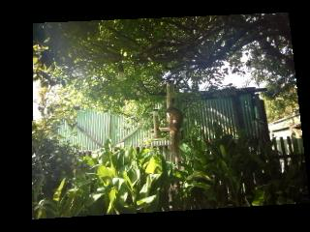
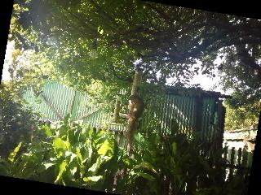
Not Enough Images (Too Many Empty)
Every Squirrel and Bird: Rotate, Permute
Train On Tagged Data
After Image Augmentation
Notes:
Left confusion matrix: Original training run… That is non-functional
Original Image, permuted, rotated
Right confusion matrix: After augmentation
Not great, but actually not terrible!
I also seem to have lost some data somewhere along the line.

Slide 17
Run Real data (AKA: And My Troubles Began)
Once the model was installed the results were the same every image
Swap the bit order in the training images
Variation, but nonsense results
Run the TFLite Model
Gives good results: Replace Onxx-Tensorflow with onnx2tf
Run on board: Every image the same
Wake up in the middle of the night, the memory must be off
Increase the Arena size, and don’t let the camera run time run.
Variation!!
Put the model into play the next morning: Every image the same results.
Notes:
If I changed the model training, I would get a different result.. But still the same for every image.
Mr Lin suggested running the TFLite model in python on my desktop.
The model is no good! Same results at every image.
Mr Lin subgested changing out onnx-tensorflow with onnx2tf… Hay, remember that compiler warngin way back when?
What was it: Something about onnx-tensorflow being past end of life
Changing Converter out… Non trivial task.
Still no joy. This makes not sense! Everything is the same, what could be different.

Slide 18
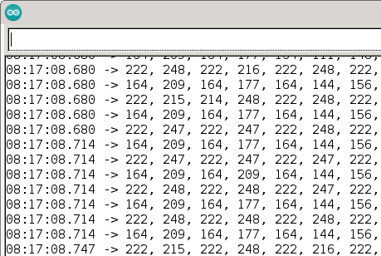
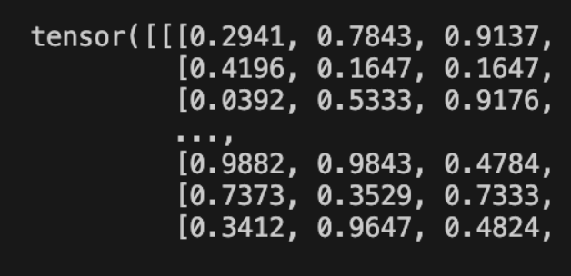
At night it works, but in the daytime it doesn’t
Image Directly From Camera
Image Directly From DataLoader
Notes:
Image on the board: 0 – 255, Image in python 0.0 to 1.0
Low light give variation of result!
The image intensity is too high.
The DataLoader is normalizing to 1!

Slide 19

… Still Every Image the Same Results
Still no joy. ARRRRGH!
Go for a run, clear my head
When I get back
Run the pipeline from the beginning
Different Results!! … But non-sensical
Swap the byte order on the training data
Notes:
Write down every step.
Change the filenames for the model as I go.
RGB2BGR
It works!!!

Slide 20
It Works!
Time train for real.
Gather All the images.
Set the model to save when it has a squirrel or a bird
Manually tag, using false positives in the “Empty” set
Switch to a faster MobileNetV5
Get model small enough to fit on Spresense
Iterate on the training and Hyperparameters
Analyze data
Write Presentation
Practice Presentation

Slide 21
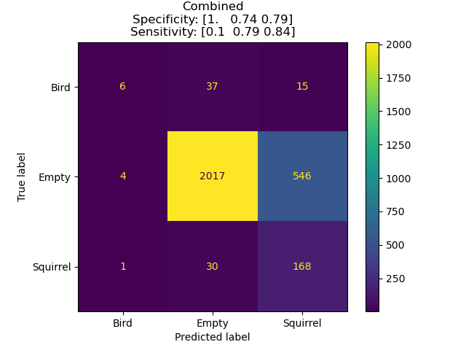
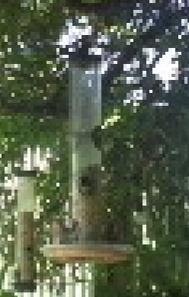
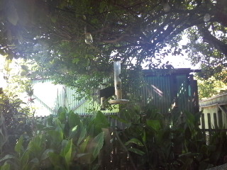
New Plan: Run With What I Have
Data run on real-time:
Incorrectly Predicted
Image of a Bird
(Empty)
Correctly Predicted
Image of a Bird
Notes:
The performance is actually not terrible! Ok, its bad, but not terrible. Ok, maybe its terrible. But it IS functional!
Well, for empty vs. squirrel anyway. Birds, not so much.
Looking at some of the bird data I think I know why:
There seems to be a theme here with the correct birds, and the incorrect birds…

Slide 22
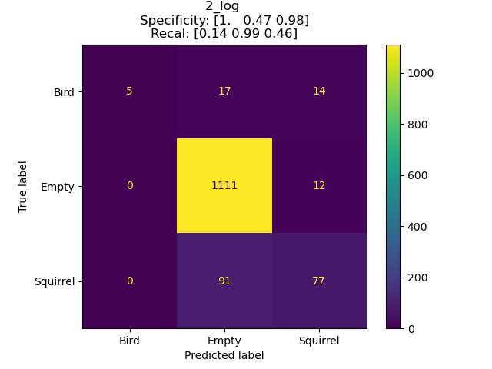
Re-Train on Larger Dataset
Before Re-Training
Run After Re-Training
Notes:
Much better for empty… much worse for squirrel.
Still trash with birds.
Gimme another week, maybe 2, and I can definitely train it up. Especially if I re-tag for larger birds only

Slide 23
MobileNetV1
Size:
PyTorch Size: 71.2MB
TfLite: 18MB
Max Size for Spresense: << 1 MB
Training
Run
Notes:
Or better yet, get MobileNetV1 Working
That’s almost down to our required size…

Slide 24
References
Krause, S. K., Kelt, D. A., & Van Vuren, D. H. (2010). Invasion, damage, and control options for eastern fox squirrels. In Proceedings of the Vertebrate Pest Conference (Vol. 24, No. 24).
https://developer.sony.com/spresense/product-specifications
Singla, N. (2014). Motion detection based on frame difference method. International Journal of Information & Computation Technology, 4(15), 1559-1565.
LeCun, Y., Boser, B., Denker, J. S., Henderson, D., Howard, R. E., Hubbard, W., & Jackel, L. D. (1989). Backpropagation applied to handwritten zip code recognition. Neural computation, 1(4), 541-551.

